Slide 1

SAGAR GROUP OF INSTITUTE RESEARCH AND TECHNOLOGY, BHOPAL
DEPARTMENT OF AIML
IPL WIN PROBABILITY PREDICTOR MODEL
H.O.D.: Coordinator:-
Dr. Kalpana Rai Prof. Vineet Kumar
Guided By:- TEAM-Member:-
Prof. Neha Sharma Aamir Siddhiqui
Aman Saxena
Chirag Jain
Madhur Choursia

Slide 2

TOPICS
Objective of Project
Problem Statement
Literature Survey
Proposed Methodology
Technology Used
Result
Future Work & Conclusion
References
•

Slide 3
Objective of Project
Build a machine learning model that predicts win probability of an IPL team
in real-time.
Predict outcome based on teams, score, wickets, overs.
Predict outcome based on teams, score, wickets, overs.
Helpful for fans, analysts, and cricket strategists .

Slide 4
PROBLEM STATEMENT
01
02
No Interactive Platform for Match Outcome Prediction
Need for a data-driven, real-time prediction tool
03
04
Challenge: integrate live data with accurate algorithms
Can we reduce the unpredictability of cricket with machine learning?”

Slide 5
1. Machine Learning in Sports
ML is widely used to predict outcomes in sports like football, basketball, and cricket.
Models like Logistic Regression and Decision Trees are common in match predictions.
LITERATURE SURVEY
2. IPL and Data-Driven Decisions
IPL teams now use data analytics for strategy, performance review, and decision-making.
Our model supports this trend by offering real-time match insights.
“We built on existing research and focused on solving real-time prediction challenges in cricket”
3. Challenges in Cricket Prediction
Outcomes can be affected by sudden changes: player form, pitch, weather.
Real-time data handling is complex but crucial for accurate prediction.

Slide 6
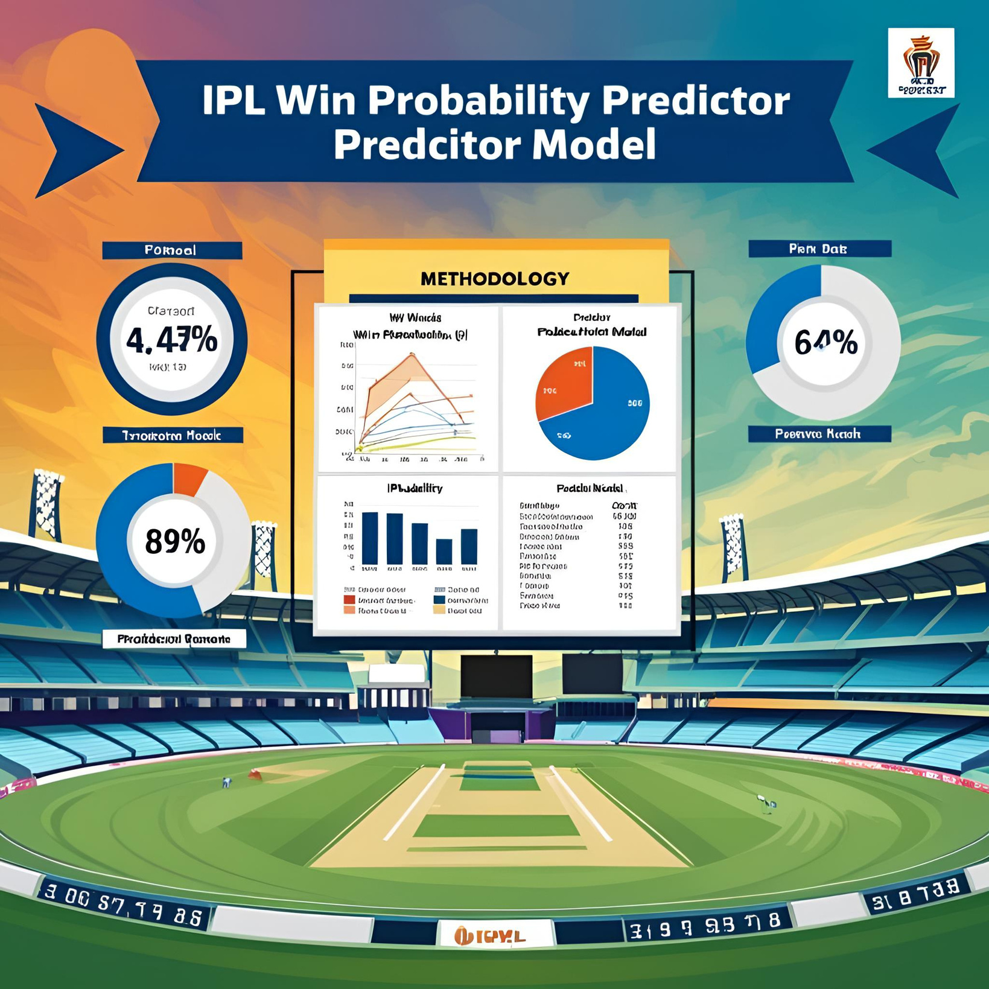
Proposed Methodology
This project uses historical IPL data and machine learning to predict the win chances of a team in a live match.
01
Data Collection
02
Data Preprocessing
03
Feature Engineering
04
Model Selection and Training

Slide 7
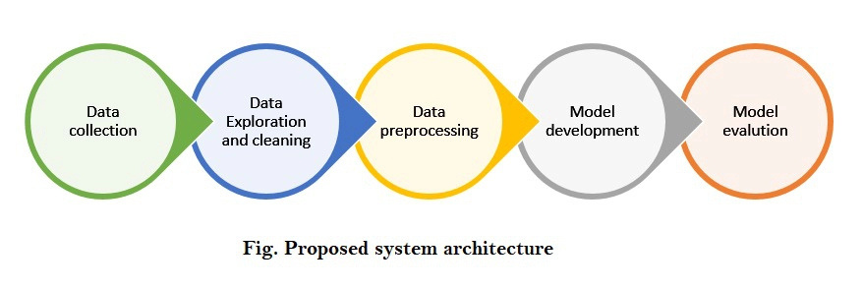

Slide 8

DATA COLLECTION
📥 Dataset Source
📊 Key Data Used
✅ Why This Dataset
IPL 2008–2019 dataset from Kaggle
Batting & Bowling Team
City & Venue
Current Score & Target
Overs & Wickets
Match Result & Winner
Real, historical IPL data
Covers detailed match situations
Perfect for training a match outcome prediction model

Slide 9


DATA PREPROCESSING
Steps we followed
01
Removed Missing Values :
Cleaned the dataset to avoid errors during model training.
02
Converted Text Data to Numbers : Used One-Hot Encoding to convert team names, cities, etc., into numerical format
03
Selected Relevant Features : Choose only important columns needed for prediction (like score, overs, wickets).
04
Handled Data Consistency :
Made sure all entries were in the same format and scale.

Slide 10

To improve prediction accuracy, we created these important features:
Feature Engineering
01
Runs Left
➤ Target Score - Current Score
🧠 New Features We Created
02
Balls Left
➤ 120 - (Overs Completed × 6)
03
Current Run Rate (CRR)
➤ Current Score ÷ Overs Completed\
04
Required Run Rate (RRR)
➤ Runs Left ÷ Balls Left
05
Wickets Remaining
➤ 10 - Wickets Fallen

Slide 11
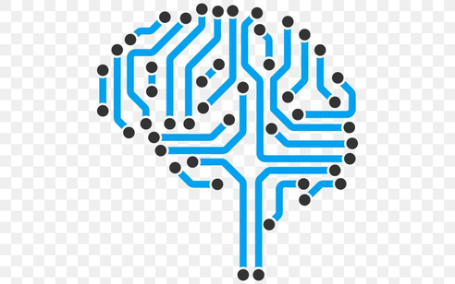
MODEL SELECTION & TRAINING
Training Process
Model Used: Logistic Regression
Pipeline created with:
OneHotEncoder for categorical features (teams, city)
LogisticRegression (with solver = 'liblinear')
Trained on historical IPL data (2008–2019)
Evaluated using accuracy_score:
Accuracy Achieved: 80.3%
Testing & Prediction
Model tested using test data
Also applied to simulate match progression over 20 overs
Prediction shown as win/lose probability at end of each over
A simple and effective algorithm for predicting win/loss (binary classification).
Chosen for its speed, interpretability, and good accuracy

Slide 12
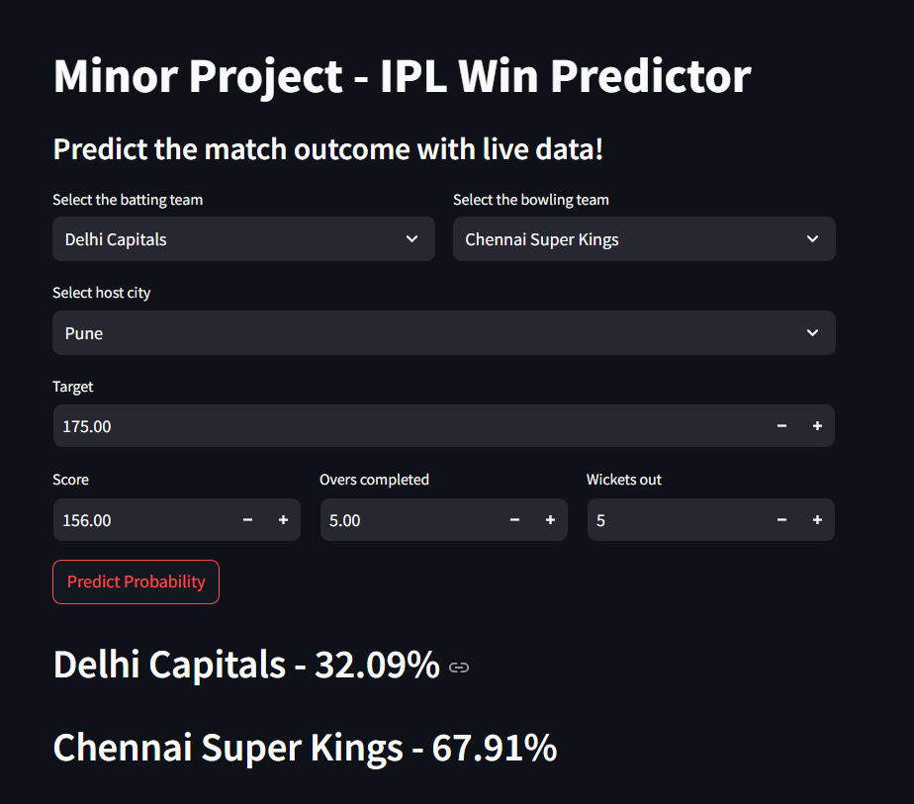
WEB APPLICATION
Developed Using: Streamlit
Lightweight Python framework for building data apps quickly
Key Functionalities
Users select:
Batting & Bowling Teams
Match City
Target Score
Current Score, Overs, Wickets
Click "Predict Probability" to get results
⚡ Instant Prediction
Shows win percentage for both teams based on current match data

Slide 13


TECHNOLOGY USED
“We used a combination of Python tools and ML libraries to bring this prediction system to life.”
Programming & Libraries
Framework & Modelling
Web Development
Python – Core language for development
pandas, numpy – Data processing & numerical calculations
scikit-learn – Machine Learning model building
matplotlib – Graphs for match progression visualization
Jupyter Notebook – For model training and experimentation
Pipeline & ColumnTransformer – To streamline preprocessing + model steps
Streamlit –
For building the interactive web application

Slide 14
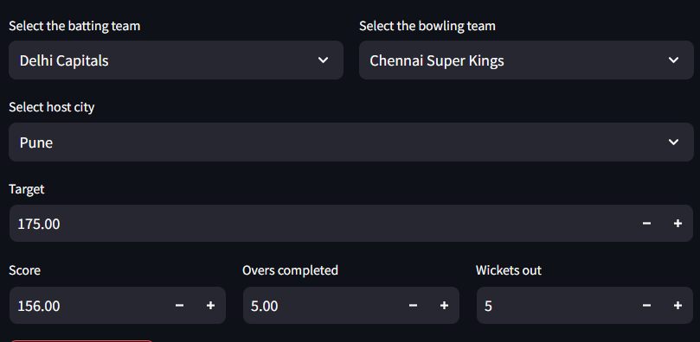
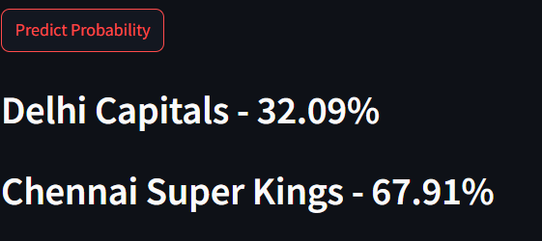
RESULT
Following results achieved :
•Logistic regression gave consistent accuracy
• Streamlit app predicts win probability in real-time
• Enhances engagement for fans and analysts

Slide 15
“What if your fantasy team decisions were backed by AI?”
Future Work & Conclusion
Add Player-Level Data
➤ Use batting/bowling averages, recent form, and fitness to improve predictions
Real-Time Data Integration
➤ Connect with live match APIs to automate input
Use Advanced Models
➤ Try Random Forests, XGBoost, or Neural Networks for better accuracy
More IPL Seasons
➤ Include latest IPL data to make the model more robust
FUTURE WORK

Slide 16
Future Work & Conclusion
“What if your fantasy team decisions were backed by AI?”
Developed a machine learning model for predicting IPL match outcomes
Used Logistic Regression and achieved over 80% accuracy
Built a Streamlit-based web app for live user interaction
Project demonstrates the power of ML in sports analytics
CONCLUSION

Slide 17

REFERENCES
1. IPL Dataset – Kaggle (2008–2020)
LINK- https://www.kaggle.com/datasets/nowke9/ipldata
2. Hands-On ML by Aurélien Géron
3. Logistic Regression: A Short Introduction by M.J. Wainwright

Slide 18
THANK YOU

